Slide 1
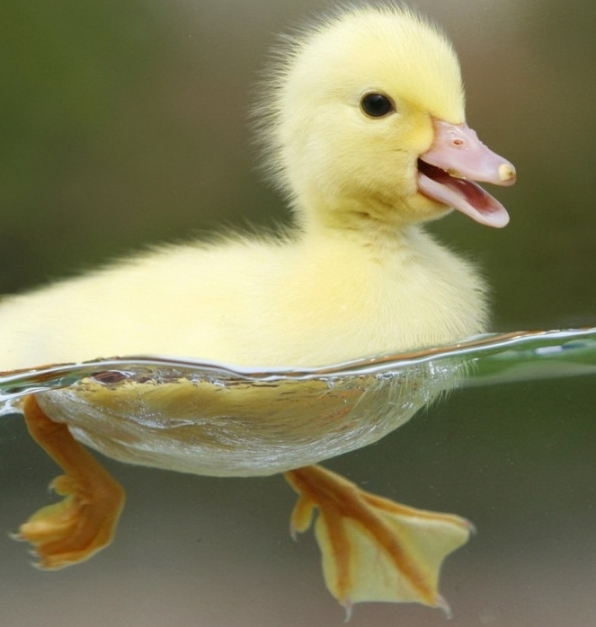
Adaptations
by Science Doodles

Slide 2
Definitions
Structure – A body part; an organization of tissues on an organism
Function – the way something works or what it can do

Slide 3
Beaver
large, hard, thick tail
pack mud to build shelter

Slide 4
Seal
thick fur
protect from cold and predators

Slide 5
Tuna
large tail
swim fast to catch prey

Slide 6
Squirrel
sharp claws
climbing trees and gathering food

Slide 7
Duck
webbed feet
swims in water

Slide 8
Bison
hoofed feet
travel on rocks and prairie

Slide 9
Turtle
hard shell
protection from predators

Slide 10
Parrot
large beak
crack nuts

Slide 11
Lion
sharp teeth
eat prey

Slide 12
Mouse
whiskers
feel its way around

Slide 13
Eagle
eye sight
hunting prey

Slide 14
Bat
wings
fly to get prey or escape predators

Slide 15
Tiger
striped fur
camouflage

Slide 16
Alligator
scales
protection from environment

Slide 17
Cheetah
spotted fur
camouflage

Slide 18
Flounder
Structure
flat body and both eyes on one side of its head
Function
able to lie on ocean floor and camouflage from predators

Slide 19
Artic White Fox
Structure
fur changes color from brown in the summer to white in the winter
Function
camouflage to catch prey and to protect from predators

Slide 20
Hummingbird
Structure
long narrow beak
Function
reaches into narrow flowers to drink nectar

Slide 21
Sources
http://www.bigmarinefish.com/atu.gif
http://www.bigmarinefish.com/atu.gif
http://www.stanford.edu/dept/CTL/cgi-bin/academicskillscoaching/wp-content/uploads/2012/07/baby-duck.jpg
http://www.firstpeople.us/pictures/buffalo/ls/Painting-Of-Bison-700x895.html
http://www.ecology.com/wp-content/uploads/2012/05/eastern-box-turtle.jpg
http://funtimebirdy.files.wordpress.com/2010/06/parrot_head.jpg
http://www.yogadistrict.com/wp-content/uploads/2012/03/roar.jpg
http://static3.wikia.nocookie.net/__cb20120522000534/animalcrossing/images/b/b7/Mouse.jpg
http://www.ugandatouristguide.com/images/africa-fish-eagle-uganda.jpg
http://www.allnaturalbats.org/bat4.jpg
http://www.topsixlist.com/wp-content/uploads/2013/12/Tiger.jpg
http://upload.wikimedia.org/wikipedia/commons/c/cd/Two_american_alligators.jpg
http://images.nationalgeographic.com/wpf/media-live/photos/000/002/cache/cheetahs_234_990x742.jpg
http://4.bp.blogspot.com/-itH6HjTlUTA/TWW9g7y6YSI/AAAAAAAABC0/AQ2wMzxYjBo/s1600/flounder-600.jpg
http://allwildanimals.com/wp-content/uploads/2012/04/Snow-Fox.jpg
http://www.almanac.com/sites/new.almanac.com/files/images/PlantsthatAttractHummingbirds.jpg

